Slide 1
Terpilicious Eats:
Helping College Park Make Optimal Food Decisions
GROUP 0504-10
Bekzod Akramov, Harshit Bansal, Akshay Havalgi, Austin Hom, and Vivek Sivalingam Ramanathan
December 2, 2019

Slide 2
Background

Slide 3

Background
Our target users for this are the students, faculty, staff, and other residents living in the general area of UMD and the restaurants in the community.
Data sources include Yelp, Google reviews, individual restaurant websites, and Google maps.
Brand Name: Terpilicious Eats
#FeartheFood

Slide 4
Introduction

Slide 5
Mission Statement
Our mission is to offer an informative online platform that provides useful data and information for both customers and restaurants to help make optimal food decisions around the University of Maryland, College Park.

Slide 6
Mission Objectives
We strive to provide, maintain and improve useful data and information about restaurants and customer preferences in College Park, MD
The platform shall help users make restaurant decisions based on ratings and reviews from customers about their restaurant experiences, which can also help restaurants to improve their services and offers
Increase public awareness and knowledge with the goal of helping people make informed food decisions
Connect students, faculty, and other residents with local restaurants, and vice versa

Slide 7
Database Design

Slide 8
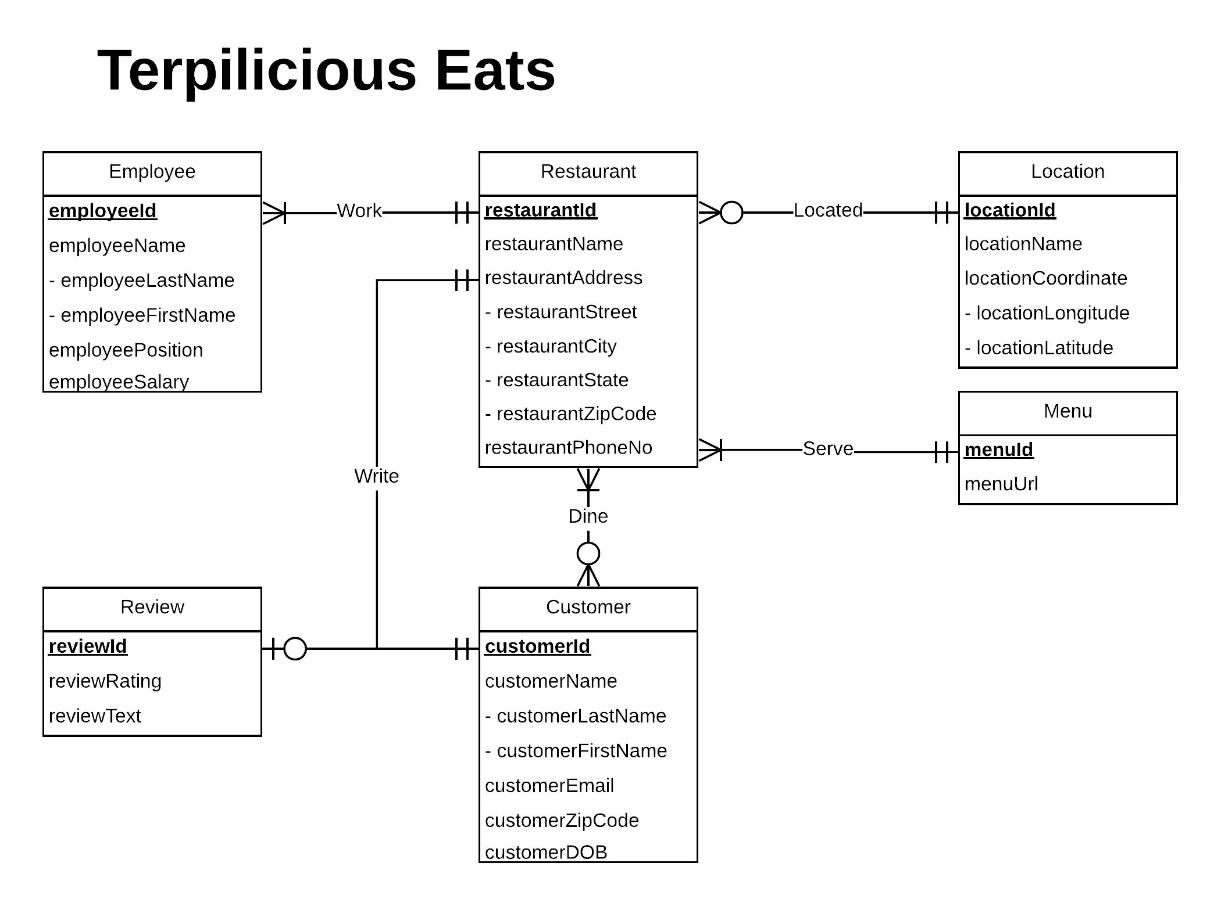
ER DIAGRAM

Slide 9
Relational Schema
Restaurant(restaurantId, restaurantName, restaurantStreet, restaurantCity, restaurantState, restaurantZipCode, restaurantPhoneNo, locationId, menuId)
Location(locationId, locationName, locationLongitude, locationLatitude)
Menu(menuId, menuUrl)
Review(reviewId, reviewRating, reviewText)
Customer(customerId, customerLastName, customerFirstName, customerEmail, customerZipCode, customerDOB)
Employee(employeeId, employeeLastName, employeeFirstName, employeePosition, employeeSalary, restaurantId)
Write(reviewId, restaurantId, customerId)
Dine(restaurantId, customerId)

Slide 10
Physical Database Design
CREATE TABLE [TerpEats.Restaurant] (
restaurantId CHAR (10) NOT NULL UNIQUE,
restaurantName VARCHAR (50),
restaurantStreet VARCHAR (50),
restaurantCity VARCHAR (50),
restaurantState CHAR (2),
restaurantZipCode CHAR (9),
restaurantPhoneNo CHAR (10),
locationId CHAR (10),
menuId CHAR(10),
CONSTRAINT pk_Restaurant_restaurantId PRIMARY KEY (restaurantId),
CONSTRAINT fk_Restaurant_locationId FOREIGN KEY (locationId)
REFERENCES [TerpEats.Location] (locationId)
ON DELETE NO ACTION ON UPDATE CASCADE,
CONSTRAINT fk_Restaurant_menuId FOREIGN KEY (menuId)
REFERENCES [TerpEats.Menu] (menuId)
ON DELETE NO ACTION ON UPDATE CASCADE );

Slide 11
Business Transactions

Slide 12
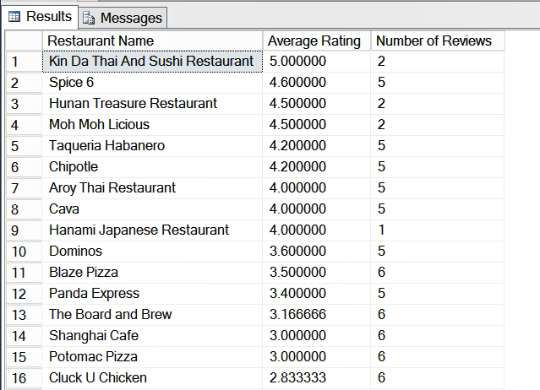
What are the names of the restaurants ranked by their average rating?
SELECT r.restaurantName AS ‘Restaurant Name’, AVG(v.reviewRating) AS "Average Rating", COUNT(v.reviewId) "Number of Reviews"
FROM [TerpEats.Restaurant] r, [TerpEats.Review] v, [TerpEats.Write] w
WHERE r.restaurantId = w.restaurantId AND
v.reviewId = w.reviewId
GROUP BY r.restaurantId, r.restaurantName
ORDER BY "Average Rating" DESC

Slide 13
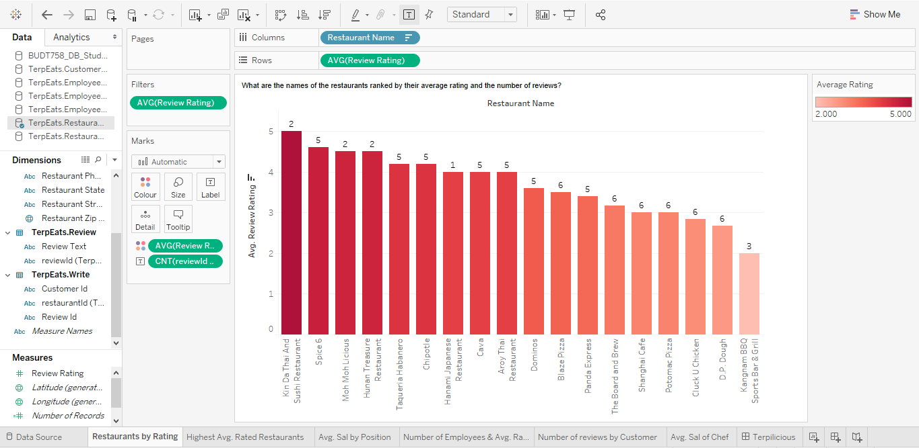
What are the names of the restaurants ranked by their average rating?

Slide 14
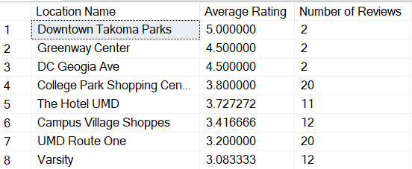
Which locations offer the restaurants with the highest average ratings?
SELECT l.locationName as 'Location Name', AVG(v.reviewRating) AS 'Average Rating', COUNT(v.reviewId) AS 'Number of Reviews'
FROM [TerpEats.Location] l, [TerpEats.Restaurant] r, [TerpEats.Review] v, [TerpEats.Write] w
WHERE r.restaurantId = w.restaurantId
AND v.reviewId = w.reviewId
AND r.locationId = l.locationId
GROUP BY l.locationName
ORDER BY "Average Rating" DESC, "Number of Reviews" DESC

Slide 15
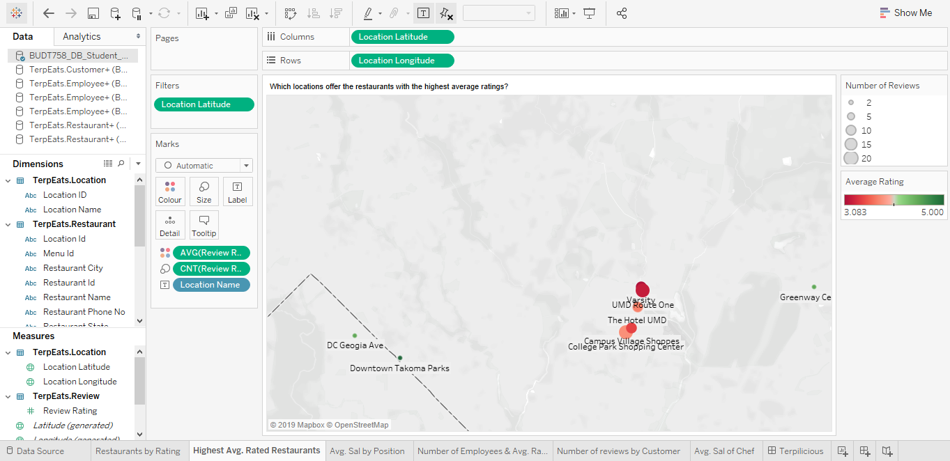
Which locations offer the restaurants with the highest average ratings?

Slide 16
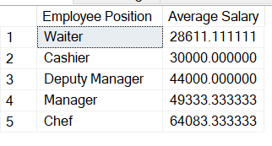
What is the average salary of employees by employee position?
SELECT e.employeePosition AS 'Employee Position', AVG(e.employeeSalary) AS 'Average Salary'
FROM [TerpEats.Employee] e
GROUP BY e.employeePosition
ORDER BY "Average Salary" ASC

Slide 17
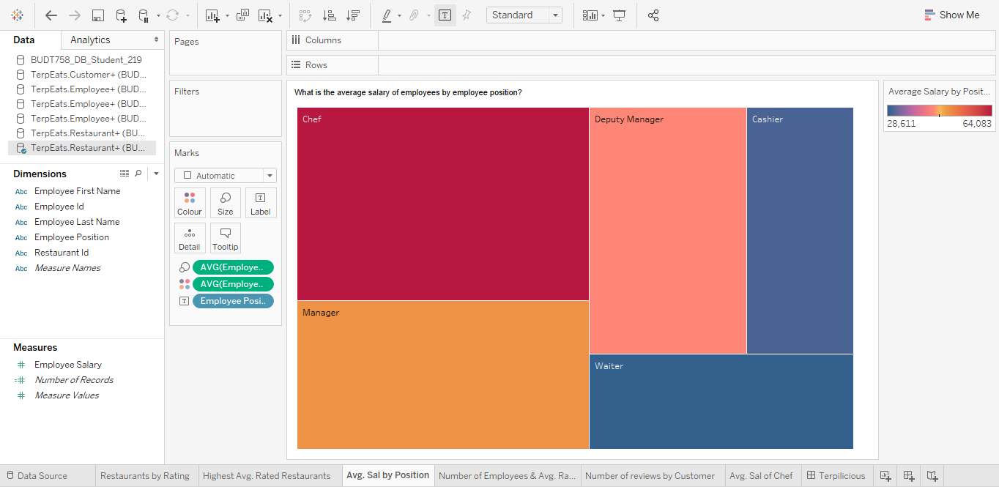
What is the average salary of employees by employee position?

Slide 18
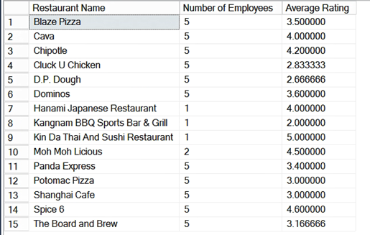
What are the number of employees and the average rating of restaurants?
SELECT r.restaurantName AS 'Restaurant Name', count(DISTINCT e.employeeId) AS 'Number of Employees', avg(v.reviewRating) AS 'Average Rating'
FROM [TerpEats.Employee] e, [TerpEats.Restaurant] r, [TerpEats.Review] v, [TerpEats.Write] w
WHERE e.restaurantId = r.restaurantId AND v.reviewId = w.reviewId
AND w.restaurantId = r.restaurantId
GROUP BY r.restaurantName
ORDER BY r.restaurantName

Slide 19
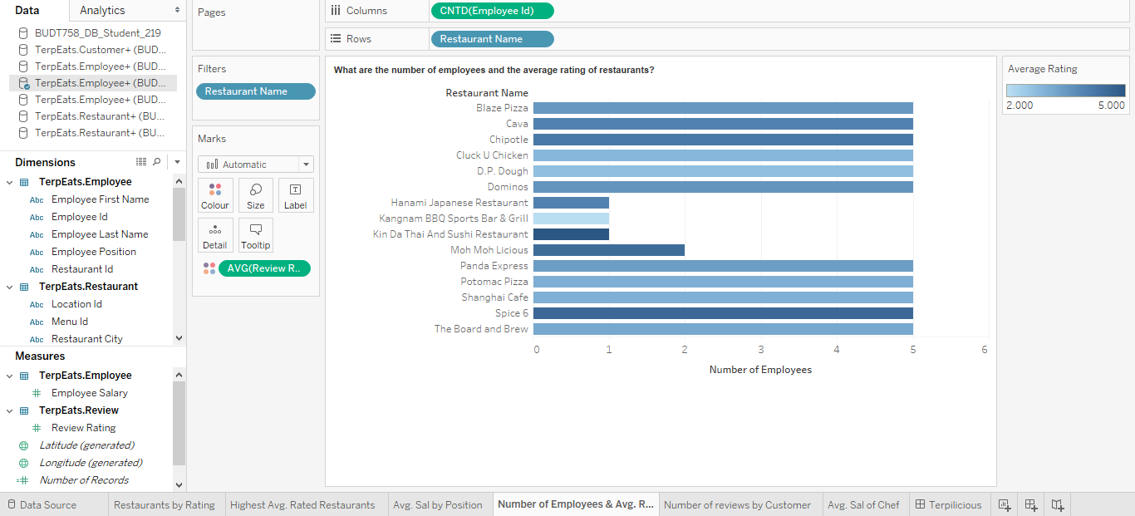
What are the number of employees and the average rating of restaurants?

Slide 20
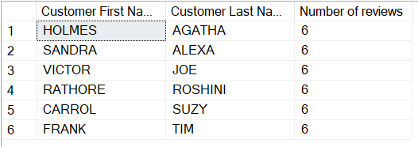
Which customers have written the most reviews?
SELECT customerLastName AS "Customer First Name", customerFirstName AS "Customer Last Name", COUNT(w.reviewId) AS 'Number of reviews'
FROM [TerpEats.Write] w, [TerpEats.Customer] c, [TerpEats.Review] r
WHERE w.customerId = c.customerId
and w.reviewId = r.reviewId
GROUP BY customerLastName, customerFirstName
HAVING COUNT(w.reviewId) = (select MAX(a.count_Reviews) as 'Max_reviews'
FROM (SELECT c.customerLastName, c.customerFirstName, COUNT(w.reviewId) AS 'count_Reviews'
FROM [TerpEats.Write] w, [TerpEats.Customer] c,[TerpEats.Review] r
WHERE w.customerId = c.customerId
and w.reviewId = r.reviewId
group by c.customerLastName, c.customerFirstName
)a)

Slide 21
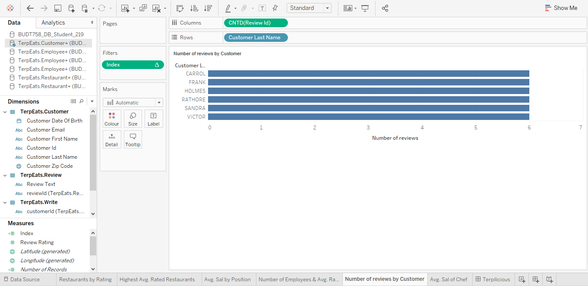
Which customers have written the most reviews?

Slide 22
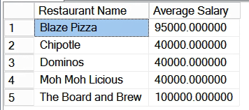
What is the average salary of Chefs at restaurants which have average ratings greater than 3?
SELECT r.restaurantName AS ‘Restaurant Name’,AVG(e.employeeSalary) AS 'Average Salary'
FROM [TerpEats.Employee] e,[TerpEats.Restaurant] r, [TerpEats.Review] v, [TerpEats.Write] w
WHERE e.employeePosition = 'Chef'
AND e.restaurantId = r.restaurantId
AND r.restaurantId = w.restaurantId
AND v.reviewId = w.reviewId
GROUP BY r.restaurantName
HAVING avg(v.reviewRating)>3

Slide 23
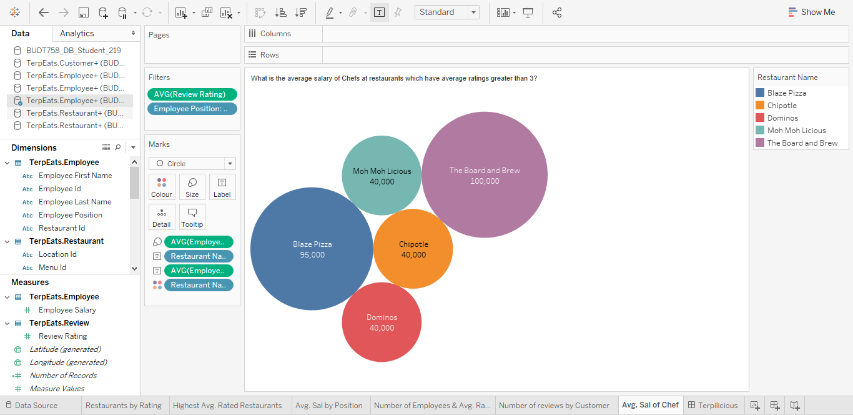
What is the average salary of Chefs at restaurants which have average ratings greater than 3?

Slide 24
Questions?

Slide 25
Bekzod Akramov | Harshit Bansal | Akshay Havalgi | Austin Hom | Vivek Sivalingam Ramanathan
feedback@terpiliciouseats.umd. edu

